Slide 1
Bank Loan Case Study
analysis performed on Application dataset

Slide 2
Approach
The approach will be to perform the tasks in an organized way, creating separate sheets in the workbook for different tasks performed.
The project analysis follows the below mentioned steps:
Step 1: Data Cleaning (Null values removal & imputation, duplicates removal, outliers detection, irrelevant columns removal)
Step 2: Univariate Analysis
Step 3: Fraud Analysis
Step 4: Bivariate Analysis
Step 5: Correlation Analysis

Slide 3
Irrelevant columns deleted
NAME_CONTRACT_TYPEa | NONLIVINGAPARTMENTS_AVG | FONDKAPREMONT_MODE
FLAG_OWN_CAR | NONLIVINGAREA_AVG | HOUSETYPE_MODE
CNT_CHILDREN | APARTMENTS_MODE | TOTALAREA_MODE
AMT_GOODS_PRICE | BASEMENTAREA_MODE | WALLSMATERIAL_MODE
NAME_TYPE_SUITE | YEARS_BEGINEXPLUATATION_MODE | EMERGENCYSTATE_MODE
NAME_INCOME_TYPE | YEARS_BUILD_MODE | OBS_30_CNT_SOCIAL_CIRCLE
REGION_POPULATION_RELATIVE | COMMONAREA_MODE | DEF_30_CNT_SOCIAL_CIRCLE
DAYS_EMPLOYED | ELEVATORS_MODE | OBS_60_CNT_SOCIAL_CIRCLE
DAYS_REGISTRATION | ENTRANCES_MODE | DEF_60_CNT_SOCIAL_CIRCLE
OWN_CAR_AGE | FLOORSMAX_MODE | FLAG_DOCUMENT_2
FLAG_EMAIL | FLOORSMIN_MODE | FLAG_DOCUMENT_3
REGION_RATING_CLIENT | LANDAREA_MODE | FLAG_DOCUMENT_4
REGION_RATING_CLIENT_W_CITY | LIVINGAPARTMENTS_MODE | FLAG_DOCUMENT_5
WEEKDAY_APPR_PROCESS_START | LIVINGAREA_MODE | FLAG_DOCUMENT_6
HOUR_APPR_PROCESS_START | NONLIVINGAPARTMENTS_MODE | FLAG_DOCUMENT_7
EXT_SOURCE_1 | NONLIVINGAREA_MODE | FLAG_DOCUMENT_8
EXT_SOURCE_2 | APARTMENTS_MEDI | FLAG_DOCUMENT_9
EXT_SOURCE_3 | BASEMENTAREA_MEDI | FLAG_DOCUMENT_10
APARTMENTS_AVG | YEARS_BEGINEXPLUATATION_MEDI | FLAG_DOCUMENT_11
BASEMENTAREA_AVG | YEARS_BUILD_MEDI | FLAG_DOCUMENT_12
YEARS_BEGINEXPLUATATION_AVG | COMMONAREA_MEDI | FLAG_DOCUMENT_13
YEARS_BUILD_AVG | ELEVATORS_MEDI | FLAG_DOCUMENT_14
COMMONAREA_AVG | ENTRANCES_MEDI | FLAG_DOCUMENT_15
ELEVATORS_AVG | FLOORSMAX_MEDI | FLAG_DOCUMENT_16
ENTRANCES_AVG | FLOORSMIN_MEDI | FLAG_DOCUMENT_17
FLOORSMAX_AVG | LANDAREA_MEDI | FLAG_DOCUMENT_18
FLOORSMIN_AVG | LIVINGAPARTMENTS_MEDI | FLAG_DOCUMENT_19
LANDAREA_AVG | LIVINGAREA_MEDI | FLAG_DOCUMENT_20
LIVINGAPARTMENTS_AVG | NONLIVINGAPARTMENTS_MEDI | FLAG_DOCUMENT_21
LIVINGAREA_AVG | NONLIVINGAREA_MEDI
89 irrelevant columns were deleted which were not required for our analysis

Slide 4
Null values analysis
Column Name | SK_ID_CURR | TARGET | CODE_GENDER | FLAG_OWN_REALTY | AMT_INCOME_TOTAL | AMT_CREDIT | AMT_ANNUITY | NAME_EDUCATION_TYPE | NAME_FAMILY_STATUS | NAME_HOUSING_TYPE | DAYS_BIRTH | DAYS_ID_PUBLISH | FLAG_MOBIL | FLAG_EMP_PHONE | FLAG_WORK_PHONE | FLAG_CONT_MOBILE | FLAG_PHONE | OCCUPATION_TYPE | CNT_FAM_MEMBERS | REG_REGION_NOT_LIVE_REGION | REG_REGION_NOT_WORK_REGION | LIVE_REGION_NOT_WORK_REGION | REG_CITY_NOT_LIVE_CITY | REG_CITY_NOT_WORK_CITY | LIVE_CITY_NOT_WORK_CITY | ORGANIZATION_TYPE | DAYS_LAST_PHONE_CHANGE | AMT_REQ_CREDIT_BUREAU_HOUR | AMT_REQ_CREDIT_BUREAU_DAY | AMT_REQ_CREDIT_BUREAU_WEEK | AMT_REQ_CREDIT_BUREAU_MON | AMT_REQ_CREDIT_BUREAU_QRT | AMT_REQ_CREDIT_BUREAU_YEAR
Null Value %age | 0 | 0 | 0 | 0 | 0 | 0 | 0.002 | 0 | 0 | 0 | 0 | 0 | 0 | 0 | 0 | 0 | 0 | 31.3086 | 0.002 | 0 | 0 | 0 | 0 | 0 | 0 | 0 | 0.002 | 13.4683 | 13.4683 | 13.4683 | 13.4683 | 13.4683 | 13.4683
Occupation_type column has been dropped due to the presence of > 30% null values

Slide 5
Data Imbalance
We have data imbalance in our dataset, hence, the results would be skewed, we cannot generalize the findings of target 1 as it only represents 8% of our sample, rest 92% represents target 0.

Slide 6
Feature Engineering
1. AMT_REQ_CREDIT_BUREAU_YEAR_Total – Following 6 columns were clubbed to create a new column
AMT_REQ_CREDIT_BUREAU_HOUR
AMT_REQ_CREDIT_BUREAU_DAY
AMT_REQ_CREDIT_BUREAU_WEEK
AMT_REQ_CREDIT_BUREAU_MON
AMT_REQ_CREDIT_BUREAU_QRT
AMT_REQ_CREDIT_BUREAU_YEAR
2. DAYS_ID_PUBLISH – Values were converted into positive values through absolute function.
3. Days_Birth – The column values were converted into positive year values.
4. Days_last_phone_change - The column values were converted into positive values.

Slide 7
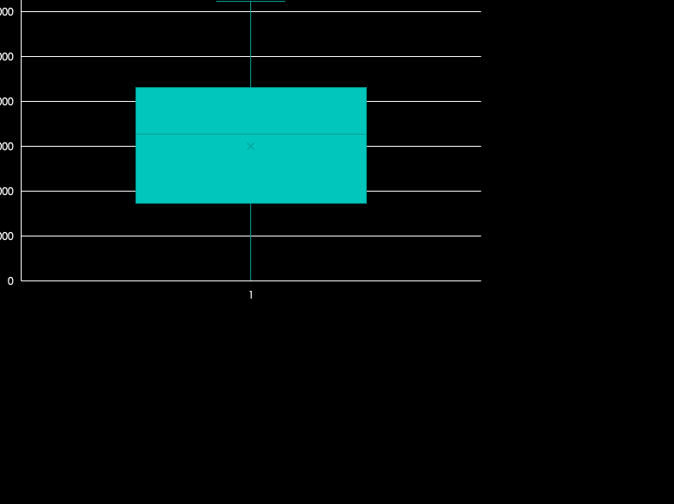
Data distribution
The data contains no outliers and no null values.

Slide 8
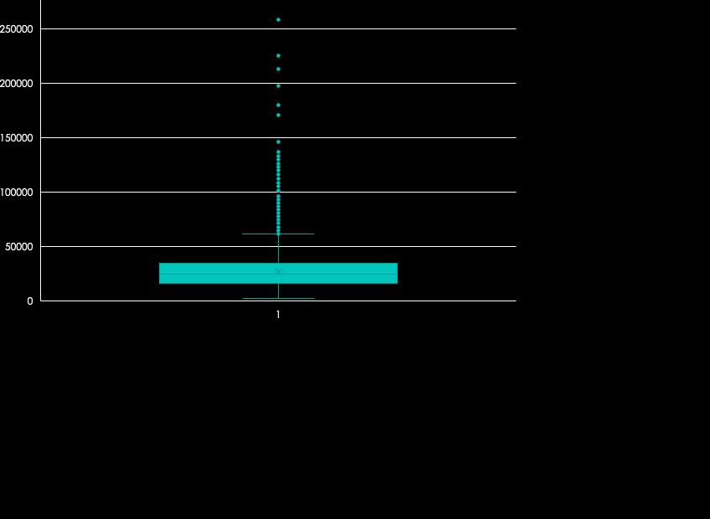
Data distribution
Quartiles | AMT_ANNUITY
Q1 | 112500
Q2 (median) | 146250
Q3 | 202500
Q4 | 117000000
Q3-Q1 | 90000
Lower Bound | -22500
Upper Bound | 337500
Null values in Amt_Annuity column have been replaced with median value due to the presence of outliers in our data.
Median = 24939
The values beyond lower and upper bound were identified as outliers. But these values were not replaced as extremes in annuity are possible.

Slide 9
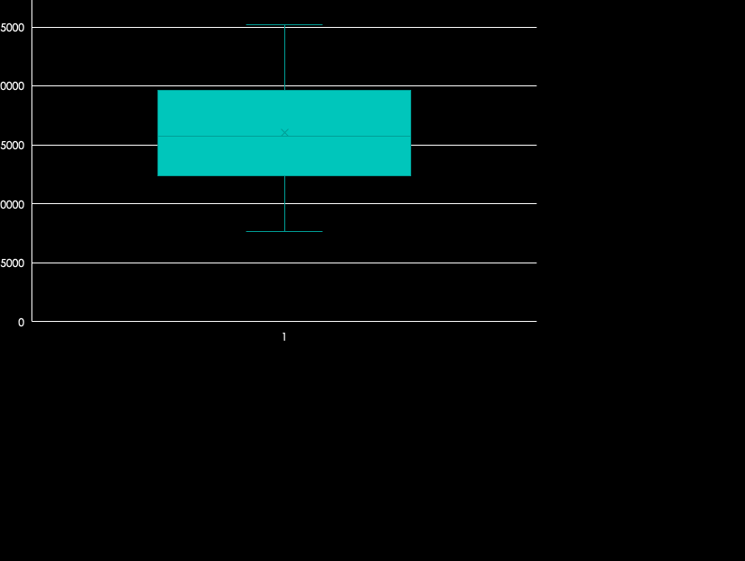
Data distribution
The data contains no outlier and no null value.

Slide 10
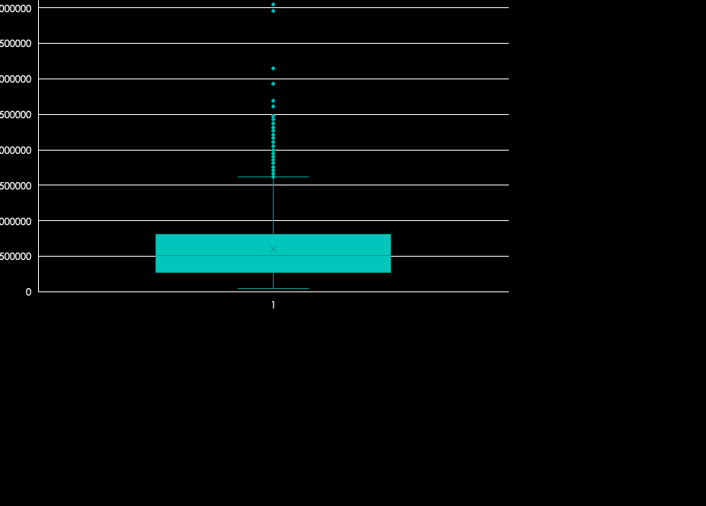
Data distribution
The dataset contains outliers but replacing these data points is not an ideal choice as credit amount varies highly for customers.
Also, no null values were found.

Slide 11

Data distribution
Null values in Cnt_Fam_Members column have been replaced with median value due to the presence of outliers in our data.
Median = 2
But outliers have not been replaced as the highest value in the dataset is 13 which is possible. A family can have 13 members.

Slide 12

Data distribution
Quartiles | DAYS_LAST_PHONE_CHANGE
Q1 | 270
Q2 (median) | 755
Q3 | 1573
Q4 | 4002
Q3-Q1 | 1303
Lower Bound | -1684.5
Upper Bound | 3527.5
Null values in Days_Last_Phone_Change column have been replaced with median value due to the presence of outliers in our data.
The data points were converted into positive values with ABS function.
Outliers have also been replaced with median value. Values beyond lower and upper bound are outliers.

Slide 13
Attribute analysis
General Analysis
Fraud detection
bifurcation on the basis of
Target
Target
0
0
1
0
1
CODE_GENDER
CODE_GENDER
DAYS_LAST_PHONECHANGE
DAYS_LAST_PHONECHANGE
FLAG_OWN_REALTY
FLAG_OWN_REALTY
DAYS_ID_PUBLISH
DAYS_ID_PUBLISH
NAME_EDUCATION_TYPE
NAME_EDUCATION_TYPE
FLAG_CONT_MOBILE
FLAG_CONT_MOBILE
NAME_FAMILY_STATUS
NAME_FAMILY_STATUS
NAME_HOUSING_TYPE
NAME_HOUSING_TYPE
DAYS_BIRTH
DAYS_BIRTH
CNT_FAM_MEMBERS
CNT_FAM_MEMBERS
ORGANIZATION_TYPE
ORGANIZATION_TYPE
AMT_REQ_CREDIT_BUREAU_YEAR_Total
AMT_REQ_CREDIT_BUREAU_YEAR_Total

Slide 14
Univariate Analysis

Slide 15
TARGET
Row Labels | Count of TARGET
0 | 45973
1 | 4026
Grand Total | 49999
Label | Representation
0 | Customers with no payment difficulties
1 | Customers with payment difficulties
Most of the customers had no payment difficulties, only 8% customers made late payment of installment

Slide 16
CODE_GENDER
Row Labels | Count of CODE_GENDER | Count of CODE_GENDER (%)
F | 32823 | 65.65%
M | 17174 | 34.35%
XNA | 2 | 0.00%
Grand Total | 49999 | 100.00%
Approximately 65% of bank’s customers are females and rest are males.

Slide 17
AMT_INCOME_TOTAL
Row Labels | Count of AMT_INCOME_TOTAL
25000-125000 | 17440
125000-225000 | 21447
225000-325000 | 8506
325000-425000 | 1592
425000-525000 | 569
525000-625000 | 169
625000-725000 | 165
725000-825000 | 34
825000-925000 | 35
925000-1025000 | 2
1025000-1125000 | 4
1125000-1225000 | 13
1225000-1325000 | 1
1325000-1425000 | 10
1525000-1625000 | 1
1725000-1825000 | 2
1825000-1925000 | 1
1925000-2025000 | 1
2025000-2125000 | 2
2225000-2325000 | 2
3525000-3625000 | 1
3825000-3925000 | 1
116925000-117025000 | 1
Grand Total | 49999
Customers belonging to 125000-225000 income range are highest applicants of credit and as the income increases, the less customers apply for credit.

Slide 18
AMT_CREDIT
Row Labels | Count of AMT_CREDIT
0-1000000 | 41853
1000000-2000000 | 7823
2000000-3000000 | 319
3000000-4000000 | 2
4000000-5000000 | 2
Grand Total | 49999
Smaller value loans of upto Rs. 100000 are mostly applied for.

Slide 19
DAYS_BIRTH_YEAR
Row Labels | Count of DAYS_BIRTH_year
22-31 | 7302
32-41 | 13422
42-51 | 12489
52-61 | 11020
62-71 | 5766
Grand Total | 49999
Most of the applicants belong to the 32-51 years age bracket.

Slide 20
AMT_ANNUITY
Row Labels | Count of AMT_ANNUITY
0-25000 | 25128
25000-50000 | 21434
50000-75000 | 3107
75000-100000 | 245
100000-125000 | 55
125000-150000 | 17
150000-175000 | 4
175000-200000 | 2
200000-225000 | 1
225000-250000 | 5
250000-275000 | 1
Grand Total | 49999
Most of the annuities are lower in value and annuities beyond Rs. 150000 are very less in number.

Slide 21
Segmented Univariate Analysis

Slide 22
0 – Customers with no payment difficulties
CODE_GENDER
Row Labels 0 | Count of CODE_GENDER | Count of CODE_GENDER(%)
F | 30559 | 66.47%
M | 15412 | 33.52%
XNA | 2 | 0.00%
Grand Total | 45973 | 100.00%
Approximately 66% of customers who faced no payment difficulties were females.

Slide 23
1 – Customers with payment difficulties
CODE_GENDER
Row Labels 1 | Count of CODE_GENDER | Count of CODE_GENDER(%)
F | 2264 | 56.23%
M | 1762 | 43.77%
Grand Total | 4026 | 100.00%
Females faced more payment difficulties in comparison to males.

Slide 24
0 – Customers with no payment difficulties
FLAG_OWN_REALTY
Row Labels (0) | Count of FLAG_OWN_REALTY
N | 14034
Y | 31939
Grand Total | 45973
69% of customers who had no payment issues had own property

Slide 25
1 – Customers with payment difficulties
FLAG_OWN_REALTY
Row Labels (1) | Count of FLAG_OWN_REALTY
N | 1274
Y | 2752
Grand Total | 4026
68% of customers who had payment difficulties had own property.

Slide 26
0 – Customers with no payment difficulties
NAME_EDUCATION_TYPE
Row Labels | Count of NAME_EDUCATION_TYPE
Academic degree | 20
Higher education | 11561
Incomplete higher | 1482
Lower secondary | 547
Secondary / secondary special | 32363
Grand Total | 45973
71% of the customers who faced no payment difficulties had education level upto secondary/ secondary special.

Slide 27
1 – Customers with payment difficulties
NAME_EDUCATION_TYPE
Row Labels | Count of NAME_EDUCATION_TYPE
Higher education | 606
Incomplete higher | 138
Lower secondary | 73
Secondary / secondary special | 3209
Grand Total | 4026
80% of the customers who faced payment difficulties had education level upto secondary/ secondary special.

Slide 28
0 – Customers with no payment difficulties
NAME_FAMILY_STATUS
Row Labels | Count of NAME_FAMILY_STATUS
Civil marriage | 4377
Married | 29699
Separated | 2870
Single / not married | 6577
Unknown | 1
Widow | 2449
Grand Total | 45973
Most of the customers who did not face payment difficulties were married.

Slide 29
1 – Customers with payment difficulties
NAME_FAMILY_STATUS
Row Labels | Count of NAME_FAMILY_STATUS
Civil marriage | 482
Married | 2395
Separated | 272
Single / not married | 729
Widow | 148
Grand Total | 4026
Most of the customers who faced payment difficulties were also married.

Slide 30
0 – Customers with no payment difficulties
NAME_HOUSING_TYPE
Row Labels | Count of NAME_HOUSING_TYPE
Co-op apartment | 176
House / apartment | 40895
Municipal apartment | 1700
Office apartment | 398
Rented apartment | 682
With parents | 2122
Grand Total | 45973
Most of the customers who faced no payment difficulties lived in own house/ apartment.

Slide 31
1 – Customers with payment difficulties
NAME_HOUSING_TYPE
Row Labels | Count of NAME_HOUSING_TYPE
Co-op apartment | 15
House / apartment | 3473
Municipal apartment | 145
Office apartment | 29
Rented apartment | 87
With parents | 277
Grand Total | 4026
Most of the customers who faced payment difficulties also lived in own house/ apartment.

Slide 32
0 – Customers with no payment difficulties
DAYS_BIRTH_YEAR
Row Labels | Count of SK_ID_CURR
20-29 | 4211
30-39 | 11801
40-49 | 12079
50-59 | 10491
60-70 | 7391
Grand Total | 45973
Most of the customers with no payment difficulties belonged to 40-49 years.

Slide 33
1 – Customers with payment difficulties
DAYS_BIRTH_YEAR
Row Labels | Count of SK_ID_CURR
20-29 | 530
30-39 | 1350
40-49 | 1031
50-59 | 719
60-70 | 396
Grand Total | 4026
Most of the customers with payment difficulties belonged to 30-39 years.

Slide 34
0 – Customers with no payment difficulties
CNT_FAM_MEMBERS
Row Labels | Count of CNT_FAM_MEMBERS
1 | 9951
2 | 23902
3 | 7858
4 | 3651
5 | 538
6 | 55
7 | 9
8 | 6
9 | 2
10 | 1
Grand Total | 45973
Most of the customers with no payment difficulties had 2 members in family.

Slide 35
1 – Customers with payment difficulties
CNT_FAM_MEMBERS
Row Labels | Count of CNT_FAM_MEMBERS
1 | 4026
1 | 922
2 | 1906
3 | 777
4 | 349
5 | 54
6 | 13
7 | 3
10 | 1
13 | 1
Grand Total | 4026
Most of the customers with payment difficulties also had 2 members in family.

Slide 36
0 – Customers with no payment difficulties
ORGANIZATION_TYPE
Most of the customers with no payment difficulties work in Business Entity type 3, and majority were also self employed.

Slide 37
1 – Customers with payment difficulties
ORGANIZATION_TYPE
Most of the customers with payment difficulties work in Business Entity type 3, and majority were also self employed.

Slide 38
0 – Customers with no payment difficulties
AMT_REQ_CREDIT_BUREAU_YEAR_TOTAL
The inquiries to credit bureau twice for most of the customers with no payment difficulties.
The columns have been clubbed to sum up the count upto 1 year.

Slide 39
1 – Customers with payment difficulties
AMT_REQ_CREDIT_BUREAU_YEAR_TOTAL
The columns have been clubbed to sum up the count upto 1 year.
The inquiries to credit bureau twice for most of the customers with payment difficulties.
But the stats are same for customers with no payment difficulties, so it can be understood that on an average inquiries were made two times for a customer in last 1 year.

Slide 40
Fraud Analysis
Row Labels | Count of DAYS_ID_PUBLISH | Count of DAYS_ID_PUBLISH2
0 | 45973 | 91.95%
0-999 | 6376 | 13.87%
1000-1999 | 6887 | 14.98%
2000-2999 | 7421 | 16.14%
3000-3999 | 8033 | 17.47%
4000-4999 | 15285 | 33.25%
5000-5999 | 1902 | 4.14%
6000-6999 | 69 | 0.15%
1 | 4026 | 8.05%
0-999 | 700 | 17.39%
1000-1999 | 719 | 17.86%
2000-2999 | 687 | 17.06%
3000-3999 | 671 | 16.67%
4000-4999 | 1132 | 28.12%
5000-5999 | 112 | 2.78%
6000-6999 | 5 | 0.12%
Grand Total | 49999 | 100.00%
No specific trend could be found.

Slide 41
Fraud Analysis
Row Labels | Count of FLAG_CONT_MOBILE
0 | 97
1 | 45876
Grand Total | 45973
This column whether the client’s phone was reachable or not.
Here, 0 represents no
1 represents yes
Majority of the clients who faced no payment difficulties had their phone reachable.

Slide 42
Fraud Analysis
Row Labels | Count of FLAG_CONT_MOBILE
0 | 4
1 | 4022
Grand Total | 4026
Majority of the clients who faced payment difficulties had their phone reachable. So, it does not seem to be a deliberate fraudulent practice of clients to bounce payments.

Slide 43
Fraud Analysis
Row Labels | Count of DAYS_LAST_PHONE_CHANGE
0 | 45973
0-364 | 13600
365-729 | 8555
730-1094 | 5565
1095-1459 | 4509
1460-1824 | 5773
1825-2189 | 3388
2190-2554 | 2373
2555-2919 | 1293
2920-3284 | 649
3285-3649 | 238
3650-4014 | 30
1 | 4026
0-364 | 1440
365-729 | 866
730-1094 | 508
1095-1459 | 343
1460-1824 | 389
1825-2189 | 235
2190-2554 | 125
2555-2919 | 81
2920-3284 | 25
3285-3649 | 14
Grand Total | 49999
Most of the applicants who have defaulted on payments have changed their phone in the last one year

Slide 44
Correlation Matrix
Overall | AMT_INCOME_TOTAL | AMT_CREDIT | AMT_ANNUITY | DAYS_BIRTH_year | DAYS_ID_PUBLISH | CNT_FAM_MEMBERS | DAYS_LAST_PHONE_CHANGE_NEW | AMT_REQ_CREDIT_BUREAU_YEAR_Total
AMT_INCOME_TOTAL | 1
AMT_CREDIT | 0.069315897 | 1
AMT_ANNUITY | 0.083008438 | 0.76949879 | 1
DAYS_BIRTH_year | -0.015871498 | 0.05911226 | -0.00804581 | 1
DAYS_ID_PUBLISH | -0.003506646 | 0.01222876 | -0.006716927 | 0.271609378 | 1
CNT_FAM_MEMBERS | 0.011225511 | 0.06399716 | 0.07737959 | -0.276365674 | 0.026074278 | 1
DAYS_LAST_PHONE_CHANGE_NEW | 0.004141658 | 0.07528529 | 0.065246635 | 0.079837875 | 0.090774609 | 0.022506978 | 1
AMT_REQ_CREDIT_BUREAU_YEAR_Total | 0.007286752 | -0.00024933 | 0.015002696 | 0.060532471 | 0.038116142 | -0.024501112 | 0.111847863 | 1
AMT_ANNUITY and AMT_CREDIT have high positive correlation as expected while no other attribute show significant correlation.

Slide 45
0 | AMT_INCOME_TOTAL | AMT_CREDIT | AMT_ANNUITY | DAYS_BIRTH_year | DAYS_ID_PUBLISH | CNT_FAM_MEMBERS | DAYS_LAST_PHONE_CHANGE_NEW | AMT_REQ_CREDIT_BUREAU_YEAR_Total
AMT_INCOME_TOTAL | 1
AMT_CREDIT | 0.377965752 | 1
AMT_ANNUITY | 0.451135167 | 0.77077282 | 1
DAYS_BIRTH_year | -0.073966771 | 0.05092406 | -0.010167705 | 1
DAYS_ID_PUBLISH | -0.032286356 | 0.00829019 | -0.00942697 | 0.270944996 | 1
CNT_FAM_MEMBERS | 0.041599302 | 0.06487694 | 0.077892626 | -0.283548577 | 0.025054258 | 1
DAYS_LAST_PHONE_CHANGE_NEW | 0.045978573 | 0.07048628 | 0.062421355 | 0.072071995 | 0.084246321 | 0.025018128 | 1
AMT_REQ_CREDIT_BUREAU_YEAR_Total | 0.054557569 | 0.00017615 | 0.014432023 | 0.059726216 | 0.035696206 | -0.025894464 | 0.114187737 | 1
Clients with no payment difficulties
There is high positive correlation between AMT_ANNUITY & AMT_CREDIT , no other substantial correlation is observed.

Slide 46
1 | AMT_INCOME_TOTAL | AMT_CREDIT | AMT_ANNUITY | DAYS_BIRTH_year | DAYS_ID_PUBLISH | CNT_FAM_MEMBERS | DAYS_LAST_PHONE_CHANGE_NEW | AMT_REQ_CREDIT_BUREAU_YEAR_Total
AMT_INCOME_TOTAL | 1
AMT_CREDIT | 0.015271444 | 1
AMT_ANNUITY | 0.018004594 | 0.7496652 | 1
DAYS_BIRTH_year | -0.008419044 | 0.14130676 | 0.007248662 | 1
DAYS_ID_PUBLISH | 0.009122006 | 0.0437719 | 0.02132109 | 0.247697382 | 1
CNT_FAM_MEMBERS | 0.013121678 | 0.06124869 | 0.075838463 | -0.197711093 | 0.044037815 | 1
DAYS_LAST_PHONE_CHANGE_NEW | -0.012642088 | 0.12091321 | 0.098610858 | 0.125790656 | 0.140069979 | 0.003474821 | 1
AMT_REQ_CREDIT_BUREAU_YEAR_Total | -0.008196542 | -0.00024734 | 0.025387094 | 0.084832424 | 0.073252128 | -0.011741962 | 0.094573561 | 1
Clients with payment difficulties
As expected there is high positive correlation between AMT_CREDIT & AMT_ANNUITY, no other significant value is observed.

Slide 47
Bivariate Analysis

Slide 48
AMT_INCOME TO AMT_CREDIT
Count of SK_ID_CURR | Column Labels
Row Labels | 0-400000 | 400000-800000 | 800000-1200000 | 1200000-1600000 | 1600000-2000000 | 2000000-2400000 | 2400000-2800000 | 2800000-3200000 | 3600000-4000000 | 4000000-4400000 | Grand Total
0-400000 | 18881 | 17394 | 8351 | 3169 | 670 | 185 | 42 | 4 |  |  | 48696
400000-800000 | 110 | 333 | 338 | 259 | 84 | 61 | 18 |  | 1 | 2 | 1206
800000-1200000 | 11 | 19 | 13 | 15 | 8 | 7 | 1 |  |  |  | 74
1200000-1600000 | 2 | 4 | 4 |  |  | 1 | 1 |  |  |  | 12
1600000-2000000 | 1 | 1 | 1 | 1 |  |  |  |  |  |  | 4
2000000-2400000 |  | 1 | 2 | 1 |  |  |  |  |  |  | 4
3600000-4000000 |  |  | 1 | 1 |  |  |  |  |  |  | 2
116800000-117200000 |  | 1 |  |  |  |  |  |  |  |  | 1
Grand Total | 19005 | 17753 | 8710 | 3446 | 762 | 254 | 62 | 4 | 1 | 2 | 49999

Slide 49
Most of the applicants belong to the lower income range and also apply for low amount of credit.
The distribution follows Poisson distribution being heavily skewed on the left.

Slide 50
Gender, Credit And Income
Count of SK_ID_CURR | Column Labels
Row Labels | 0-400000 | 400000-800000 | 800000-1200000 | 1200000-1600000 | 1600000-2000000 | 2000000-2400000 | 2400000-2800000 | 2800000-3200000 | 3600000-4000000 | 4000000-4400000 | Grand Total
F | 12689 | 11608 | 5700 | 2168 | 476 | 142 | 38 | 1 | 1 |  | 32823
0-400000 | 12632 | 11468 | 5524 | 2043 | 432 | 114 | 26 | 1 |  |  | 32240
400000-800000 | 51 | 131 | 165 | 120 | 43 | 26 | 10 |  | 1 |  | 547
800000-1200000 | 4 | 5 | 7 | 4 | 1 | 2 | 1 |  |  |  | 24
1200000-1600000 | 1 | 2 | 2 |  |  |  | 1 |  |  |  | 6
1600000-2000000 | 1 |  |  | 1 |  |  |  |  |  |  | 2
2000000-2400000 |  | 1 | 1 |  |  |  |  |  |  |  | 2
3600000-4000000 |  |  | 1 |  |  |  |  |  |  |  | 1
116800000-117200000 |  | 1 |  |  |  |  |  |  |  |  | 1
M | 6314 | 6145 | 3010 | 1278 | 286 | 112 | 24 | 3 |  | 2 | 17174
0-400000 | 6247 | 5926 | 2827 | 1126 | 238 | 71 | 16 | 3 |  |  | 16454
400000-800000 | 59 | 202 | 173 | 139 | 41 | 35 | 8 |  |  | 2 | 659
800000-1200000 | 7 | 14 | 6 | 11 | 7 | 5 |  |  |  |  | 50
1200000-1600000 | 1 | 2 | 2 |  |  | 1 |  |  |  |  | 6
1600000-2000000 |  | 1 | 1 |  |  |  |  |  |  |  | 2
2000000-2400000 |  |  | 1 | 1 |  |  |  |  |  |  | 2
3600000-4000000 |  |  |  | 1 |  |  |  |  |  |  | 1
XNA | 2 |  |  |  |  |  |  |  |  |  | 2
0-400000 | 2 |  |  |  |  |  |  |  |  |  | 2
Grand Total | 19005 | 17753 | 8710 | 3446 | 762 | 254 | 62 | 4 | 1 | 2 | 49999

Slide 51
The highest number of applicants, both male and female belong to the lower income range and apply for the low amount of credit.

Slide 52
AGE to CREDIT
Count of SK_ID_CURR | Column Labels
Row Labels | 0-400000 | 400000-800000 | 800000-1200000 | 1200000-1600000 | 1600000-2000000 | 2000000-2400000 | 2400000-2800000 | 2800000-3200000 | 3600000-4000000 | 4000000-4400000 | Grand Total
22 | 197 | 14 | 3 | 4 |  |  |  |  |  |  | 218
24 | 682 | 356 | 102 | 25 | 2 | 1 |  |  |  |  | 1168
26 | 725 | 418 | 121 | 42 | 4 | 5 |  |  |  |  | 1315
28 | 940 | 729 | 265 | 86 | 14 | 6 |  |  |  |  | 2040
30 | 1142 | 926 | 353 | 94 | 31 | 13 | 2 |  |  |  | 2561
32 | 1071 | 997 | 435 | 143 | 25 | 13 | 6 |  |  |  | 2690
34 | 1043 | 979 | 392 | 146 | 43 | 11 | 7 | 1 |  |  | 2622
36 | 951 | 905 | 416 | 155 | 31 | 15 | 1 |  |  | 1 | 2475
38 | 961 | 1035 | 509 | 226 | 55 | 13 | 4 |  |  |  | 2803
40 | 966 | 1027 | 532 | 241 | 47 | 14 | 5 |  |  |  | 2832
42 | 963 | 1014 | 580 | 214 | 55 | 15 | 1 |  |  | 1 | 2843
44 | 834 | 966 | 573 | 213 | 47 | 6 | 2 | 2 |  |  | 2643
46 | 794 | 820 | 525 | 227 | 50 | 15 | 6 |  |  |  | 2437
48 | 718 | 870 | 485 | 202 | 66 | 12 | 2 |  |  |  | 2355
50 | 706 | 793 | 459 | 207 | 31 | 11 | 4 |  |  |  | 2211
52 | 706 | 751 | 464 | 173 | 43 | 12 |  |  |  |  | 2149
54 | 714 | 881 | 493 | 189 | 53 | 16 | 4 |  | 1 |  | 2351
56 | 757 | 835 | 421 | 206 | 44 | 21 | 5 |  |  |  | 2289
58 | 706 | 861 | 423 | 169 | 31 | 17 | 3 |  |  |  | 2210
60 | 660 | 766 | 374 | 164 | 34 | 18 | 5 |  |  |  | 2021
62 | 659 | 723 | 348 | 136 | 24 | 12 | 3 | 1 |  |  | 1906
64 | 631 | 660 | 281 | 123 | 28 | 4 | 2 |  |  |  | 1729
66 | 689 | 389 | 155 | 60 | 4 | 4 |  |  |  |  | 1301
68 | 660 | 35 | 1 | 1 |  |  |  |  |  |  | 697
70 | 130 | 3 |  |  |  |  |  |  |  |  | 133
Grand Total | 19005 | 17753 | 8710 | 3446 | 762 | 254 | 62 | 4 | 1 | 2 | 49999

Slide 53
Applicants belonging to lower age groups and upper age groups above 60 years mostly apply for smaller amount of credit, while middle age applicants apply for the larger amount.

Slide 54
CREDIT vs PHONE NUMBER CHANGES
Count of SK_ID_CURR | Column Labels
Row Labels | 0-364 | 365-729 | 730-1094 | 1095-1459 | 1460-1824 | 1825-2189 | 2190-2554 | 2555-2919 | 2920-3284 | 3285-3649 | Grand Total
0-400000 | 6269 | 3927 | 2227 | 1714 | 2160 | 1210 | 825 | 430 | 173 | 70 | 19005
400000-800000 | 5293 | 3206 | 2264 | 1746 | 2133 | 1323 | 917 | 528 | 271 | 72 | 17753
800000-1200000 | 2340 | 1463 | 1097 | 927 | 1203 | 738 | 501 | 263 | 136 | 42 | 8710
1200000-1600000 | 813 | 638 | 429 | 370 | 536 | 260 | 197 | 112 | 66 | 25 | 3446
1600000-2000000 | 186 | 136 | 92 | 76 | 99 | 71 | 45 | 32 | 20 | 5 | 762
2000000-2400000 | 106 | 41 | 19 | 16 | 26 | 18 | 11 | 7 | 5 | 5 | 254
2400000-2800000 | 29 | 9 | 7 | 3 | 4 | 3 | 2 | 2 | 3 |  | 62
2800000-3200000 | 3 |  |  |  | 1 |  |  |  |  |  | 4
3600000-4000000 |  | 1 |  |  |  |  |  |  |  |  | 1
4000000-4400000 | 1 |  | 1 |  |  |  |  |  |  |  | 2
Grand Total | 15040 | 9421 | 6136 | 4852 | 6162 | 3623 | 2498 | 1374 | 674 | 219 | 49999

Slide 55
Highest number of applicants have changed their phone number in the last year in all the credit bins..

Slide 56
CREDIT to DEGREE
Count of SK_ID_CURR | Column Labels
Row Labels | Academic degree | Higher education | Incomplete higher | Lower secondary | Secondary / secondary special | Grand Total
0-400000 | 7 | 3863 | 675 | 283 | 14177 | 19005
400000-800000 | 4 | 4216 | 529 | 213 | 12791 | 17753
800000-1200000 | 3 | 2399 | 273 | 94 | 5941 | 8710
1200000-1600000 | 4 | 1142 | 118 | 24 | 2158 | 3446
1600000-2000000 | 2 | 339 | 20 | 4 | 397 | 762
2000000-2400000 |  | 161 | 4 | 2 | 87 | 254
2400000-2800000 |  | 42 | 1 |  | 19 | 62
2800000-3200000 |  | 2 |  |  | 2 | 4
3600000-4000000 |  | 1 |  |  |  | 1
4000000-4400000 |  | 2 |  |  |  | 2
Grand Total | 20 | 12167 | 1620 | 620 | 35572 | 49999

Slide 57
Highest number of applicants in all the credit ranges have education upto secondary/ secondary special.

Slide 58
Video Link
https://www.loom.com/share/a95d13c8b6ef4f3fb0ad73845f5a7a88?sid=63fa5ff8-823b-4521-b237-0d3dba89a33a
Bivariate Analysis Excel Sheet
https://docs.google.com/spreadsheets/d/1aHfwWSbqmhHyGth01-OCEUVpL2zZZEcl/edit?usp=share_link&ouid=101949921485202693908&rtpof=true&sd=true
Univariate Analysis Excel Sheet
https://docs.google.com/spreadsheets/d/1bcKn2xjE_m-4x3lEyiOavscVFcbXHLA3/edit?usp=sharing&ouid=101949921485202693908&rtpof=true&sd=true

